Slide 1
Examining Growth Rate and fall rate in foreign exchange rates
Data Science Capstone Project
By Udbhav Singh Patwal

Slide 2
Introduction
This Project is based on examining growth and fall rate of foreign exchange rates for a particular country.
Thus we are able to predict the future of exchange rates for that particular country

Slide 3
DATASET
The Dataset is taken from :-
https://www.kaggle.com/brunotly/foreign-exchange-rates-per-dollar-20002019
The data consist of exchange rate many countries with exchange rates from 2000-2019.
The data was error free with gaps in months.
The shape of data is [5712,24] of format with 23 countries and 5712 units.

Slide 4
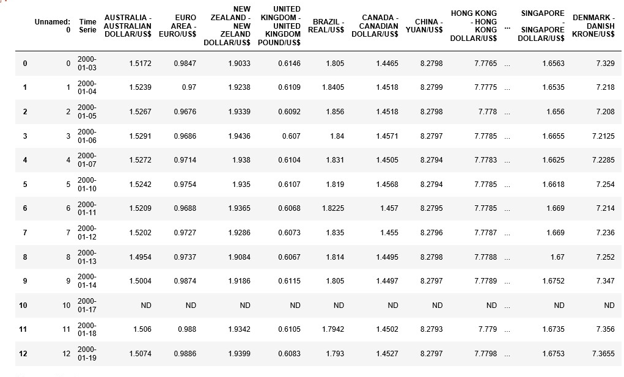
The Data View

Slide 5
PREDICTING EXCHANGE RATE
With training supervised models with the dataset we are able to predict the future exchange rates.
For e.g. Let ‘A’ be some company which wants to buy some product shares in a country ‘X’.
Now before buying shares it will want to check if it is going to get profit or not.
For this the first step comes if the country’s exchange rate isn’t going to fall.

Slide 6
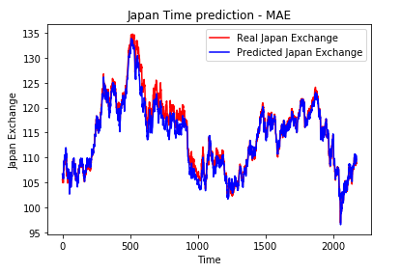
For this we need future estimation of the exchange rate.
Thus which we have built the model for.

Slide 7
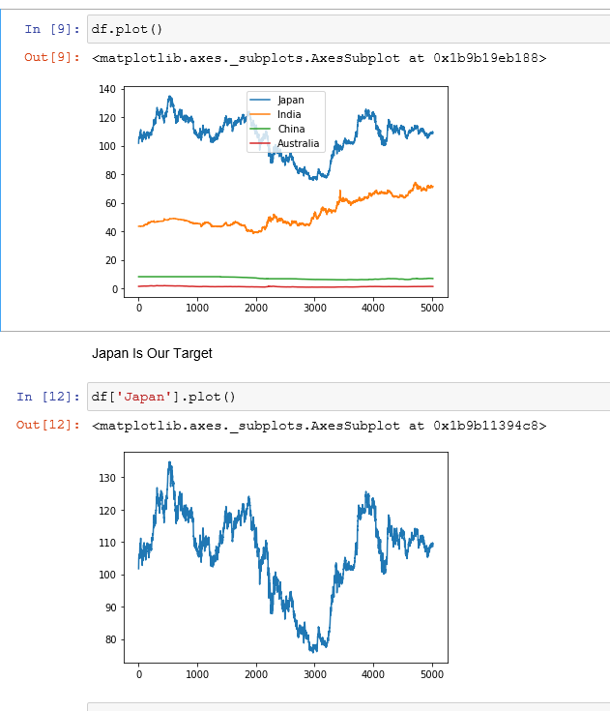
Notebook
I have powered a Jupyter notebook and created and Visualized data for model building
As well as model has been built with predicted data.
Model has been built on tensorflow.keras library.

Slide 8
THANK YOU

